Slide 1
Debiasing methods for Entity Detection in bio-medical domain
Master's Thesis presentation
Advisor Presented by,
Dr.Amit Awekar Kishore M
214101062
M.Tech 2nd year

Slide 2
What did we achieve?
Entity Detection models for Bio medical domain are biased
Existing debiasing methods have limited success
We propose two improvements to strengthen the debiasing
Trust the biased model when it has high confidence
Use relaxed evaluation criteria while determining entity boundaries
We performed experiments using three datasets, two biased models, and one unbiased model with significant improvement in debiasing
Our methods still fails to achieve complete debiasing

Slide 3
What is entity detection?
Entity is a word or sequence of words that conveys same thing.
Ex:
Corona virus is spreading widely.
Here "Corona virus" refers to an entity.
Detecting such entities and labelling them is entity detection.
We do this entity detection on Bio-medical domain.

Slide 4
Tokens are labelled using BIO tags
We label each tokens in the sentence with one of B,I,O tags.
B - Beginning of an entity
I - Inside of an entity
O - Outside of an entity
EX:
Corona virus is spreading widely .
B
I
O
O
O
O

Slide 5
Problem Statement for Entity Detection
Given a sentence (x1,x2,....xn) with n tokens.
Our aim is to predict the tag y belonging to (B,I,O) for each token.

Slide 6
Three Biomedical datasets are used
All the exisiting an proposed methods are experimented on 3 biomedical datasets.
They are,
BC5CDR
NCBI-disease
Medmentions

Slide 7
Properties of datasets
Dataset | Category | Sentences | B tags | I tags | O tags
BC5CDR | Train | 4841 | 8793 | 3502 | 101260
 | Validation
 | Test | 5146 | 8550 | 3269 | 107352
NCBI-disease | Train | 5421 | 5111 | 6048 | 12732
 | Validation
 | Test | 932 | 948 | 1052 | 22149
MedMentions | Train | 29232 | 196039 | 102501 | 434115
 | Validation
 | Test | 9763 | 65549 | 33274 | 146095

Slide 8
Models do not generalize well
-Bias problem
Existing state of the art models are not able to generalize well on new entities.
The overall performance of the model is more influenced by previously seen entities.

Slide 9
Entities are partitioned into 3 categories based on their presence/absence in training data
Memorization : Both entity and its Concept Unique Id (CUI) are present in training data.
Synonym Generalization : Only CUI is seen during training and entity of different surface form is unseen.
Concept Generalization : Both entity and its CUI are unseen. These entities are called novel entities.

Slide 10
Existing Debiasing methods

Slide 11
Debiasing Paradigms
Different debiasing methods comes under different paradigms.
Some of the paradigms are listed below,
Two Models
Knowledge Distillation
Adding Noise
Regularizer

Slide 12
Two Models

Slide 13
Debias main model with the help of bias model
This paradigm requires the use of 2 models for debiasing.
One model is to capture the bias which is called Bias model.
Another model called Main model which is debiased with the help of Bias model.

Slide 14
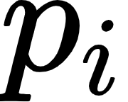
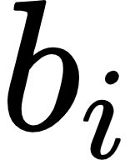
Tell the importance of the sample by ensembling
Simplest ensemble of two models is Bias product.
is probability distribution vector from Main model and is probability distribution vector from Bias model.

Slide 15
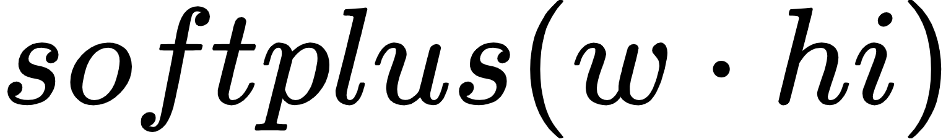
Control how much to believe bias model - Learned Mixin
Learned Mixin:
says how much to believe from bias model.
= where w is learned vector and hi is last hidden layer output.
To prevent model from ignoring bias probability, an entropy penalty is added (Learned Mixin + H).

Slide 16
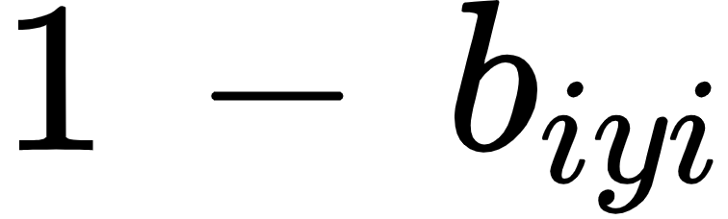
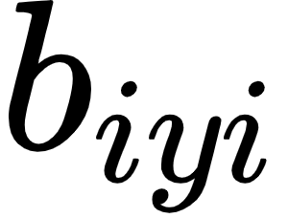
Tell the importance of sample by a weight – Re-weighting
For each sample weight is calculated with the help of bias model's probability vector of that sample.
is the weight calculated for a sample i.
is the probability value assigned by bias model on ground truth label.

Slide 17
Knowledge Distillation

Slide 18
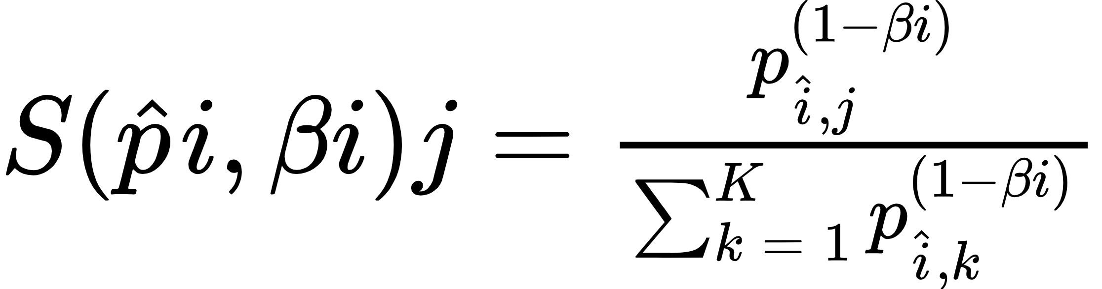
Scale the probability vector of teacher model before Distilling - Confidence Regularization
Knowledge distillation involves a Teacher model and Student model along with a Bias model to capture bias.
Teacher model and student model are parameterized identically.
The probability vector of teacher model is scaled using the probability vector of bias model and then distilled to student model.
pij is the probability value of i'th sample of j'th class of teacher model and βi is the bias probability value of ground truth class.

Slide 19
Regularizer

Slide 20
Entangle samples of same target class and Disentangle samples of same bias class
Here the bias should be known in prior.
All samples which have same bias features are grouped together and a similarity matrix is built for disentangling.
All samples which have same target class are grouped and another similarity matrix is built for entangling.
The former matrix is learned to decorrelate and later is trained to correlate as much as possible.
This is done by help of regularizer.

Slide 21
Noise

Slide 22
Add noise to entity mentions - Learnable Noise
A learnable noise matrix is created of size |C| * |C-1| of different switching possibilities of each class.
During training the noise is added to entity mentions representation from the noisy vector.
Two logits are produced for each token with respect to noisy tag and original tag.
The model collects evidence from the context to predict on original tag.
Overall objective becomes minimizing two losses independently.

Slide 23
Existing debiasing methods are designed for different tasks
We utilized their methods in entity detection task.
Bias model-1: We use class prior as our bias model.
Class prior for each token is calculated by,
Bias model-2: A small neural model with 2 layers of bilstm and a classification layer is used as another bias model.

Slide 24
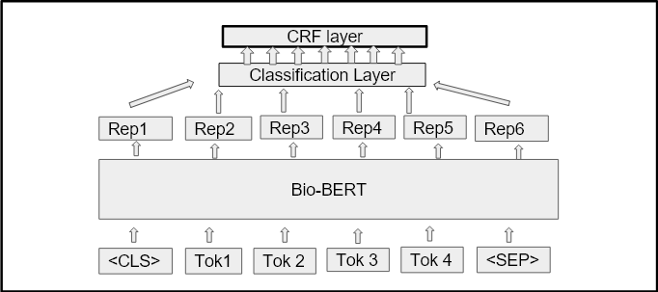
Architecture of main model
Bio BERT with CRF layer on top is used as main model.

Slide 25
Recall scores of syn and con are improved - model generalizes better
Dataset : BC5CDR Bias Model : Class Prior
Methods | Overall |  |  | Mem | Syn | Con
 | Precision | Recall | F1-Score | Recall | Recall | Recall
Vanilla | 83.5 | 86.3 | 86.3 | 95.1 | 79.0 | 81.1
POE | 81.5 | 86.1 | 83.7 | 89.8 | 79.4 | 82.4
Reweight | 76.1 | 89.3 | 82.1 | 91.8 | 84.3 | 87.1
Learned MixinH | 75.3 | 84.1 | 79.4 | 85.8 | 80.4 | 83.0

Slide 26
Recall scores of syn and con are improved - model generalizes better
Methods | Overall |  |  | Mem | Syn | Con
 | Precision | Recall | F1-Score | Recall | Recall | Recall
Vanilla | 86.3 | 90.8 | 88.5 | 96.3 | 78.6 | 83.5
POE | 81.5 | 88.3 | 84.8 | 91.3 | 81.7 | 85.2
Reweight | 77.0 | 88.4 | 82.3 | 91.8 | 80.6 | 85.2
Learned MixinH | 77.1 | 85.8 | 81.2 | 87.4 | 78.0 | 88.9
Dataset : NCBI-disease Bias Model : Class Prior

Slide 27
Why is there performance drop in memorization after debiasing?
Those entities which were missed out after debiasing have bias in training tag distribution.
EX:
Alziemer : B-6, I-0, O-0
Thrombotic : B-19, I-0, O-0
Our bias model always predicts B for such entities with very high confidence (close to 1).
Applying debiasing method to these instances results in very low loss and apparently model doesn't learn much from them.

Slide 28
Even if it is biased instance, let's learn something from it.
With debiasing we say the model not to learn anything from these entities.
Solution: Let's not apply debiasing on instances where our bias model is overconfident on ground truth tag.
With this we learn something from biased instances and improve performance on debiasing methods in memorization category.
We define overconfident in different numbers (95%, 90%, 85%) and got best results when on 90%

Slide 29
Performance of proposed approach brings recall score of memory category close to recall score of vanilla model
Dataset : BC5CDR Bias Model : Class Prior
​ Methods ​ | ​ Overall ​ |  |  | ​ Mem ​ | ​ Syn ​ | ​ Con ​
​ ​ | ​ Precision ​ | ​ Recall ​ | ​ F1-Score ​ | ​ Recall ​ | ​ Recall ​ | ​ Recall ​
Vanilla​ | 83.5​ | 86.3​ | 86.3​ | 95.1​ | 79.0​ | 81.1​
​ POE(90%) ​ | ​ 82.6 ​ | ​ 89.4 ​ | ​ 85.9 ​ | ​ 93.9 ​ | ​ 81.1 ​ | ​ 84.2 ​
​ Reweight (90%) ​ | ​ 83.1 ​ | ​ 89.9 ​ | ​ 86.4 ​ | ​ 94.4 ​ | ​ 81.6 ​ | ​ 84.8 ​
​ Learned MixinH (90%) ​ | ​ 82.0 ​ | ​ 90.2 ​ | ​ 85.9 ​ | ​ 94.4 ​ | ​ 82.1 ​ | ​ 86.0 ​

Slide 30
Recall of memory in proposed methods are close to recall of Vanilla
Methods | Overall |  |  | Mem | Syn | Con
 | Precision | Recall | F1-Score | Recall | Recall | Recall
Vanilla | 86.3 | 90.8 | 88.5 | 96.3 | 78.6 | 83.5
POE(90%) | 85.1 | 87.7 | 86.4 | 91.6 | 80.6 | 81.5
Reweight (90%) | 85.2 | 88.9 | 87.0 | 94.3 | 80.0 | 80.9
Learned MixinH(90%) | 85.6 | 89.8 | 87.7 | 94.0 | 83.2 | 83.6
Dataset : NCBI-disease Bias Model : Class Prior

Slide 31
Let's not be too harsh on entity boundary
The reported performance till now are exact match evaluation.
When the boundary of predicted entity matches exactly with ground truth entity, we consider it as true positive.
Instead of entity wise matching, we propose token wise matching with minor changes.

Slide 32
Model gets confused due to noise in the dataset
There was decrease in precision and f1 score.
Increase in False positives resulted in decrease of precision and f1 score.
Most of the false positives are adjectives.
In all 3 datasets adjectives are marked as a part of entity in some samples and not a part of entity in other samples.
To handle this, we consider all adjectives as not a part of entity and ignore them during evaluation.

Slide 33
Noisy samples in the datasets
Ground truth entity | Predicted entity
Drug - induced liver injury | liver injury
bleeding | intestinal bleeding
dysmenorrhea | primary dysmenorrhea
severe malaria | malaria
isolated foveal hypoplasia | foveal hypoplasia
unilateral retinoblastoma | isolated unilateral retinoblastoma

Slide 34
Relaxed matching evaluation better picturises the models performance
Methods | Overall |  |  | Mem | Syn | Con
 | Precision | Recall | F1-Score | Recall | Recall | Recall
Vanilla | 88.2 | 92.5 | 90.3 | 98.4 | 84.8 | 87.6
POE | 84.9 | 92.1 | 88.4 | 96.0 | 86.7 | 89.9
Reweight | 80.8 | 95.1 | 87.4 | 98.4 | 90.7 | 92.5
Learned MixinH | 78.7 | 93.5 | 85.5 | 95.7 | 90.3 | 93.0
Dataset : BC5CDR Bias Model : Class Prior

Slide 35
Relaxed match performance of proposed method
Dataset : BC5CDR Bias Model : Class Prior
Methods | Overall |  |  | Mem | Syn | Con
 | Precision | Recall | F1-Score | Recall | Recall | Recall
Vanilla | 88.2 | 92.5 | 90.3 | 98.4 | 84.8 | 87.6
POE(90%) | 85.8 | 94.2 | 89.8 | 98.6 | 88.2 | 91.2
Reweight (90%) | 87.1 | 93.6 | 90.2 | 98.4 | 87.1 | 90.2
Learned MixinH(90%) | 85.2 | 94.3 | 89.5 | 98.5 | 88.4 | 92.0

Slide 36
Relaxed match performance of Existing Debiasing method
Dataset : NCBI-disease Bias Model : Class Prior
Methods | Overall |  |  | Mem | Syn | Con
 | Precision | Recall | F1-Score | Recall | Recall | Recall
Vanilla | 94.2 | 95.3 | 94.8 | 98.5 | 91.8 | 91.7
POE | 91.5 | 95.5 | 93.5 | 97.2 | 92.8 | 94.7
Reweight | 88.4 | 97.1 | 92.6 | 97.0 | 96.6 | 93.0
Learned MixinH | 88.3 | 95.9 | 91.9 | 96.3 | 95.1 | 96.1

Slide 37
Relaxed Match performance of Proposed Debiasing method
​ Methods ​ | ​ Overall ​ |  |  | ​ Mem ​ | ​ Syn ​ | ​ Con ​
​ ​ | ​ Precision ​ | ​ Recall ​ | ​ F1-Score ​ | ​ Recall ​ | ​ Recall ​ | ​ Recall ​
Vanilla​ | 94.2​ | 95.3​ | 94.8​ | 98.5​ | 91.8​ | 91.7​
​ POE(90%) ​ | ​ 94.0 ​ | ​ 94.9 ​ | ​ 94.4 ​ | ​ 97.2 ​ | ​ 93.1 ​ | ​ 91.0 ​
​ Reweight (90%) ​ | ​ 94.1 ​ | ​ 95.1 ​ | ​ 94.6 ​ | ​ 98.7 ​ | ​ 91.4 ​ | ​ 90.8 ​
​ Learned MixinH(90%) ​ | ​ 93.9 ​ | ​ 95.5 ​ | ​ 94.9 ​ | ​ 98.4 ​ | ​ 94.1 ​ | ​ 91.9 ​
Dataset : NCBI-disease Bias Model : Class Prior

Slide 38
Debiasing fails in MedMentions Dataset
Applying debiasing methods to Medmentions dataset results in poor performance.
The reason is existing model performs well for Medmentions dataset.

Slide 39
Model trained on MedMentions doesn't suffer from bias
Relaxed match score of models.
​​ Models ​​ | ​​ Overall ​​ |  |  | ​​ Mem ​​ | ​​ Syn ​​ | ​​ Con ​​
​​ ​​ | ​​ Precision ​​ | ​​ Recall ​​ | ​​ F1-Score ​​ | ​​ Recall ​​ | ​​ Recall ​​ | ​​ Recall ​​
​​ LSTM Model (B) ​​ | ​​ 82.9 ​​ | ​​ 90.0 ​​ | ​​ 86.3 ​​ | ​​ 90.3 ​​ | ​​ 89.8 ​​ | ​​ 89.3 ​​
​​ Class Prior (B) ​​ | ​​ 74.1 ​​ | ​​ 79.9 ​​ | ​​ 76.9 ​​ | ​​ 80.3 ​​ | ​​ 79.4 ​​ | ​​ 79.3 ​​
​​ Bio-BERT+CRF (M) ​​ | ​​ 84.8 ​​ | ​​ 92.2 ​​ | ​​ 88.3 ​​ | ​​ 92.0 ​​ | ​​ 92.4 ​​ | ​​ 92.6 ​​

Slide 40
Bilstm as Bias model gives similar performance for Existing debiasing methods
The performance of proposed method on bilstm as bias model is almost same as vanilla model.
This bilstm bias model learns more than what it is expected to learn.
It predicts tags with high confidence (>= 0.9) for majority of instances.
So applying our proposed work is as same as not applying debiasing.

Slide 41
Thank you Questions please

